Slide 1
Can Changes in Hot Spring Composition Reflect Decadal-Scale Deformation of the Yellowstone Caldera?
Justin R. Baez | Everett L. Shock
The School of Earth and Space Exploration

Slide 2
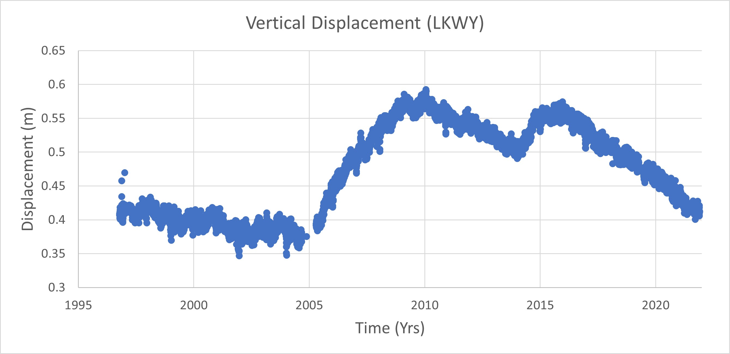
Map of YNP
Deformation at Yellowstone (YNP)
7 permanent GPS Stations on the caldera
4 show this deformation pattern
Caldera Boundary
Data sourced from the Nevada Geodetic Laboratory; (Blewitt et al. 2018)
1997-2005: Subsidence
2005-2010: Uplift
2010-2014: Subsidence
2014-2016: Uplift
2016-Present: subsidence
Modified from (Hurwitz and Lowenstern, 2014)
Notes:
This slide will highlight the areas with the observed deformation pattern and show the locations of the permanent GPS stations. Maybe spend some time highlighting some characteristics of the deformation curve.

Slide 3
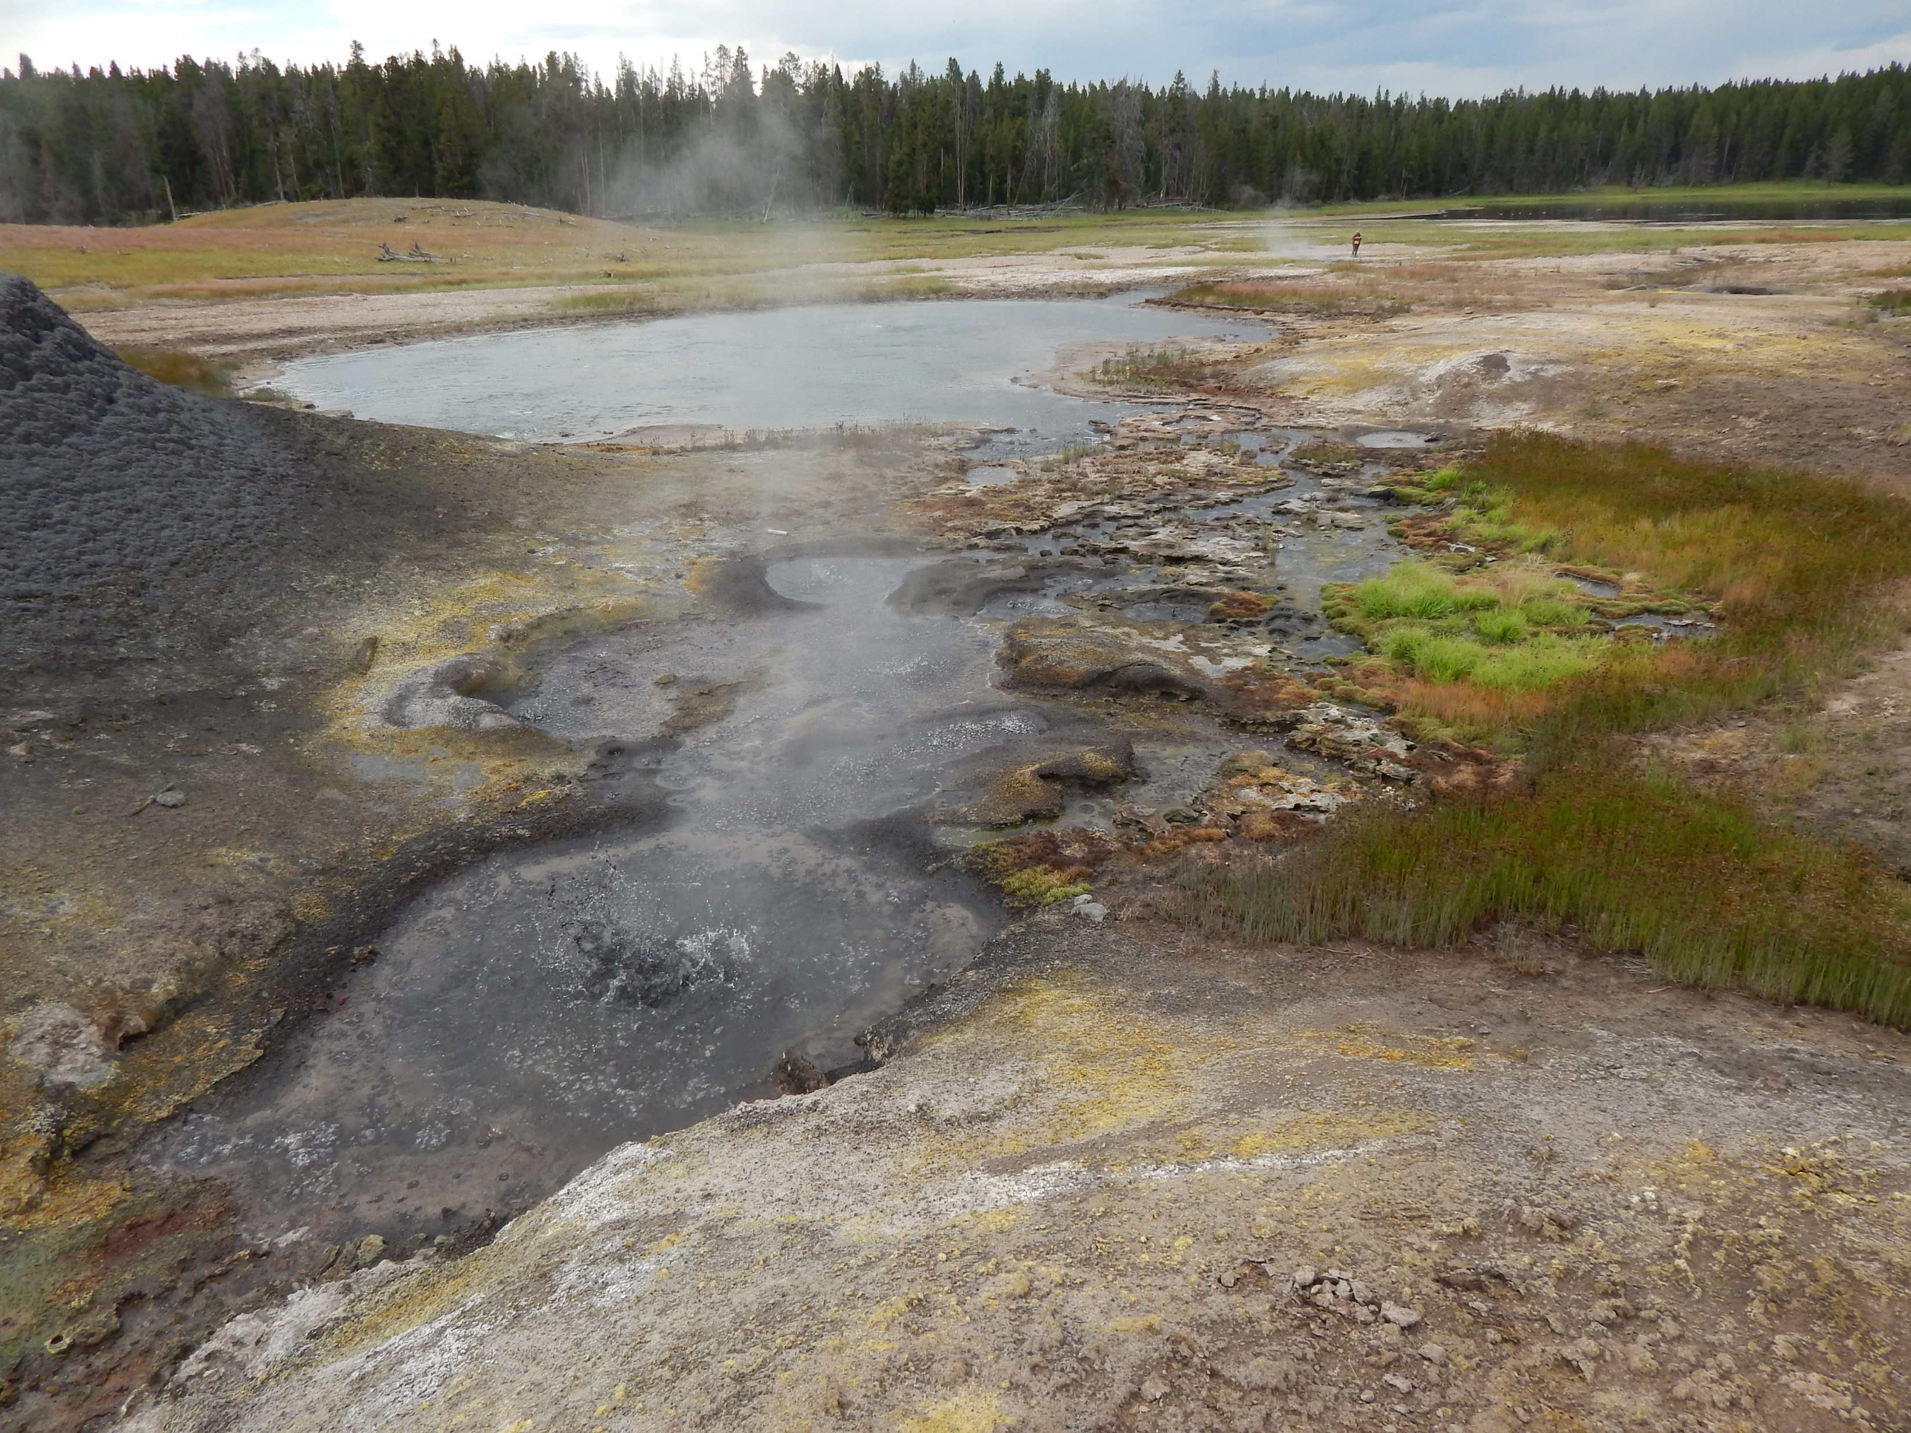
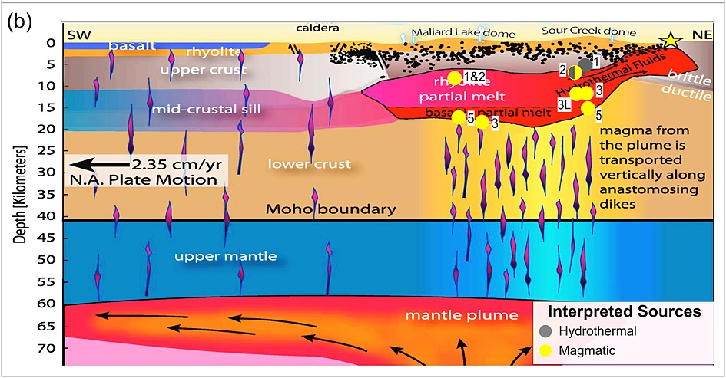
Photo by Everett Shock, Research Permit Study # YELL-05434
Data sourced from the Nevada Geodetic Laboratory; (Blewitt et al. 2018)
Deformation has been proposed to relate to changes in 1)The magmatic system, and/or
2) Hydrothermal system
Geophysical model demonstrating how the subsurface may interact with the surface.
Modified from (Tizzanni et al., 2015)
Notes:
This slide could be used to highlight the expansive geochemical data and draw the connection between the deformation and changes in geochemistry. Maybe a subsurface model can be made for this slide.
Inputs meaning: various reservoirs, magma, meteoric input, biology, geomorphology, and sediment composition.
The composition of hot springs reflect the combined influence of physical and chemical inputs.

Slide 4
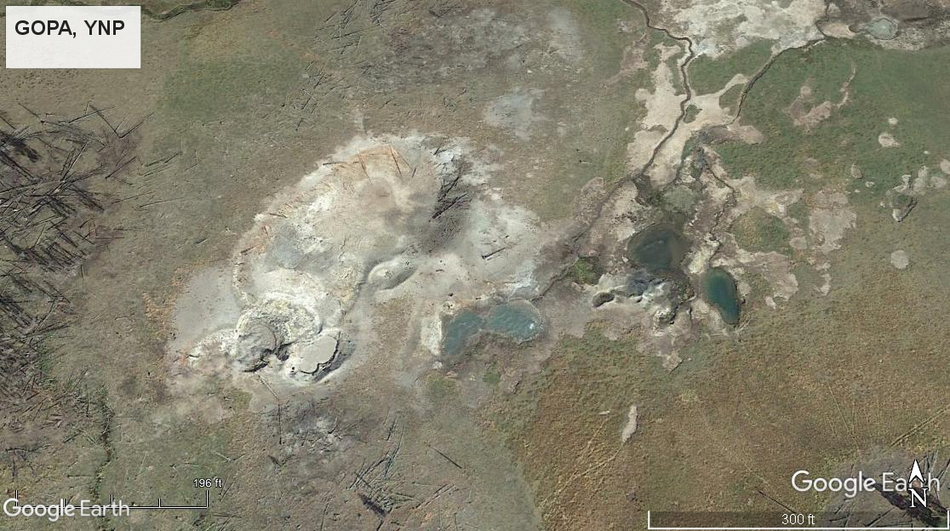

Geochemical Dataset
GEOPIG has 20+ years of overlapping Geochemical data.
Can changes in ${SO}_{4}^{−2}$(sulfate) and pH over time relate to the displacement activity?
The Greater Obsidian Pool Area (GOPA) is our study focus.
Spotted Grizzly
Figure 8
Obsidian Pool
Over the Hill Pool
Sourced from Google Earth Pro
Notes:
Discuss how this project was non hypothesis driven for a while and then we decided to look at pH and SO4. Explain why those to factors can be revealing to the activity. This slide can be easily connected with the previous slide if it shows a subsurface model. Hypothesis became that the amount of gas input changes with deformation type.
What measurements could be correlated.
This slide should briefly highlight GOPA and why we narrowed our search for a good spring system—show all the lines of reasoning. High energy flow…
(combine with slide 5)
Where could we see correlations.

Slide 5
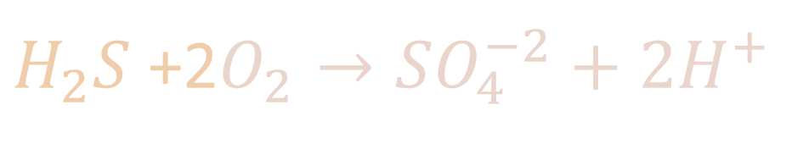

Hot Spring Chemistry
Reaction 1:
$${4SO}_{2}+4H_{2}O↔3SO_{4}^{−2}+6H^{+}+H_{2}S$$
Reaction 2:
$H_{2}S$ +2$O_{2}→SO_{4}^{−2}+2H^{+}$
${SO}_{4}^{−2}$(sulfate) can be produced in two reactions.
Via oxidation-reduction and disproportionation reactions.
Notes:
Discuss how this project was non hypothesis driven for a while and then we decided to look at pH and SO4. Explain why those to factors can be revealing to the activity. This slide can be easily connected with the previous slide if it shows a subsurface model. Hypothesis became that the amount of gas input changes with deformation type.
What measurements could be correlated.
This slide should briefly highlight GOPA and why we narrowed our search for a good spring system—show all the lines of reasoning. High energy flow…
(combine with slide 5)
Where could we see correlations.

Slide 6
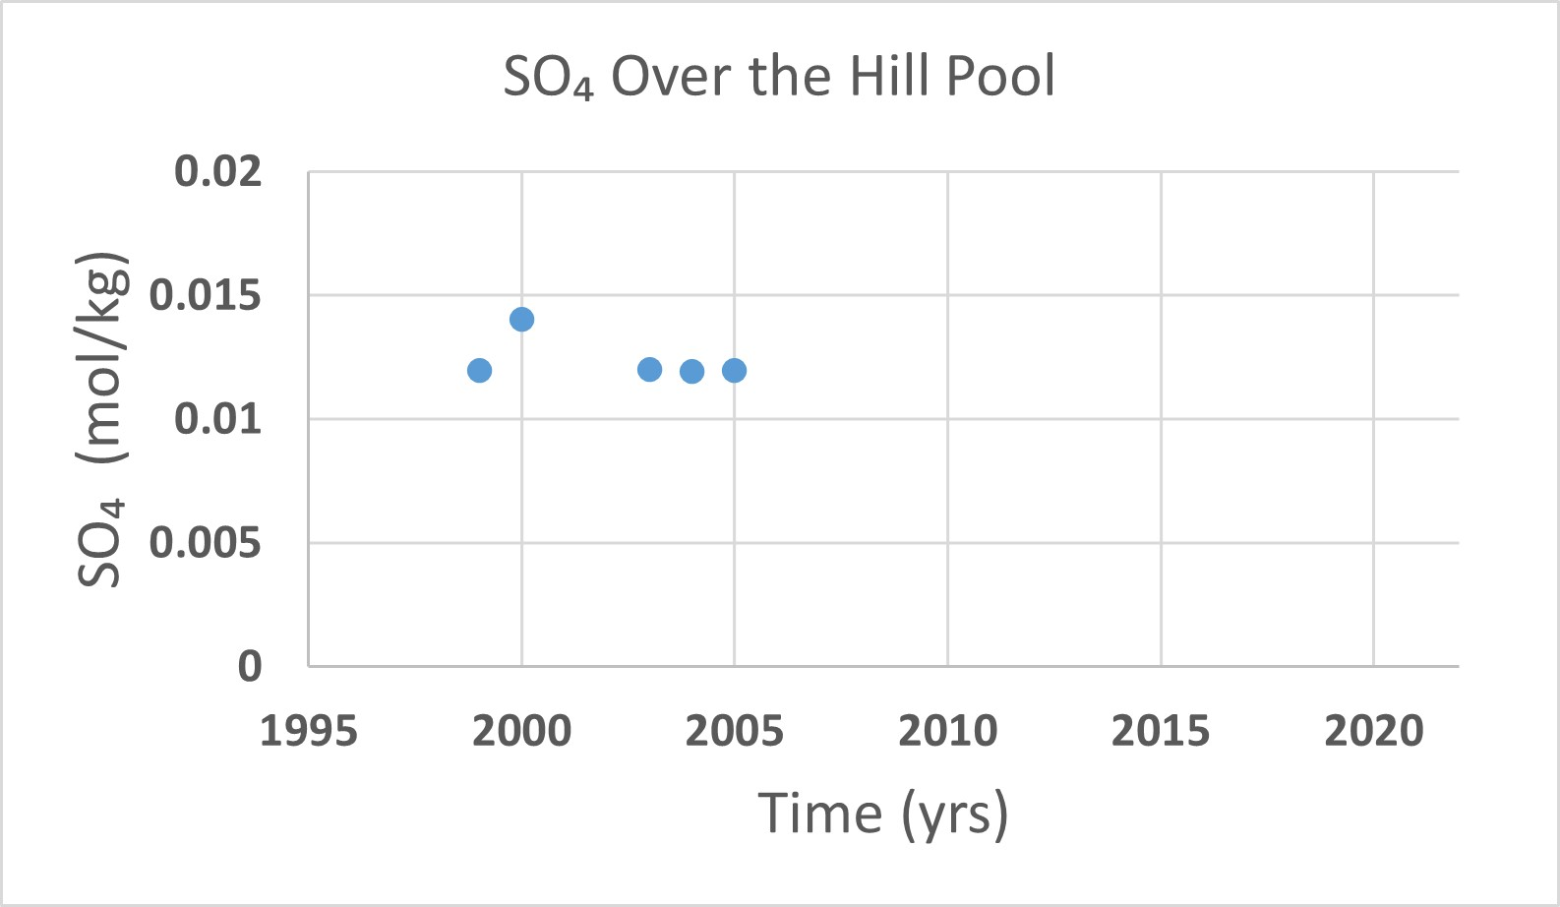
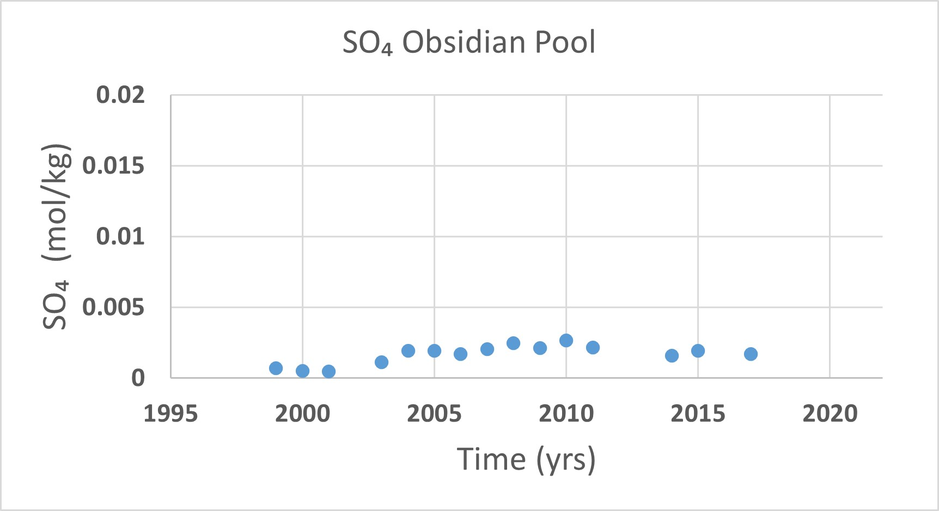
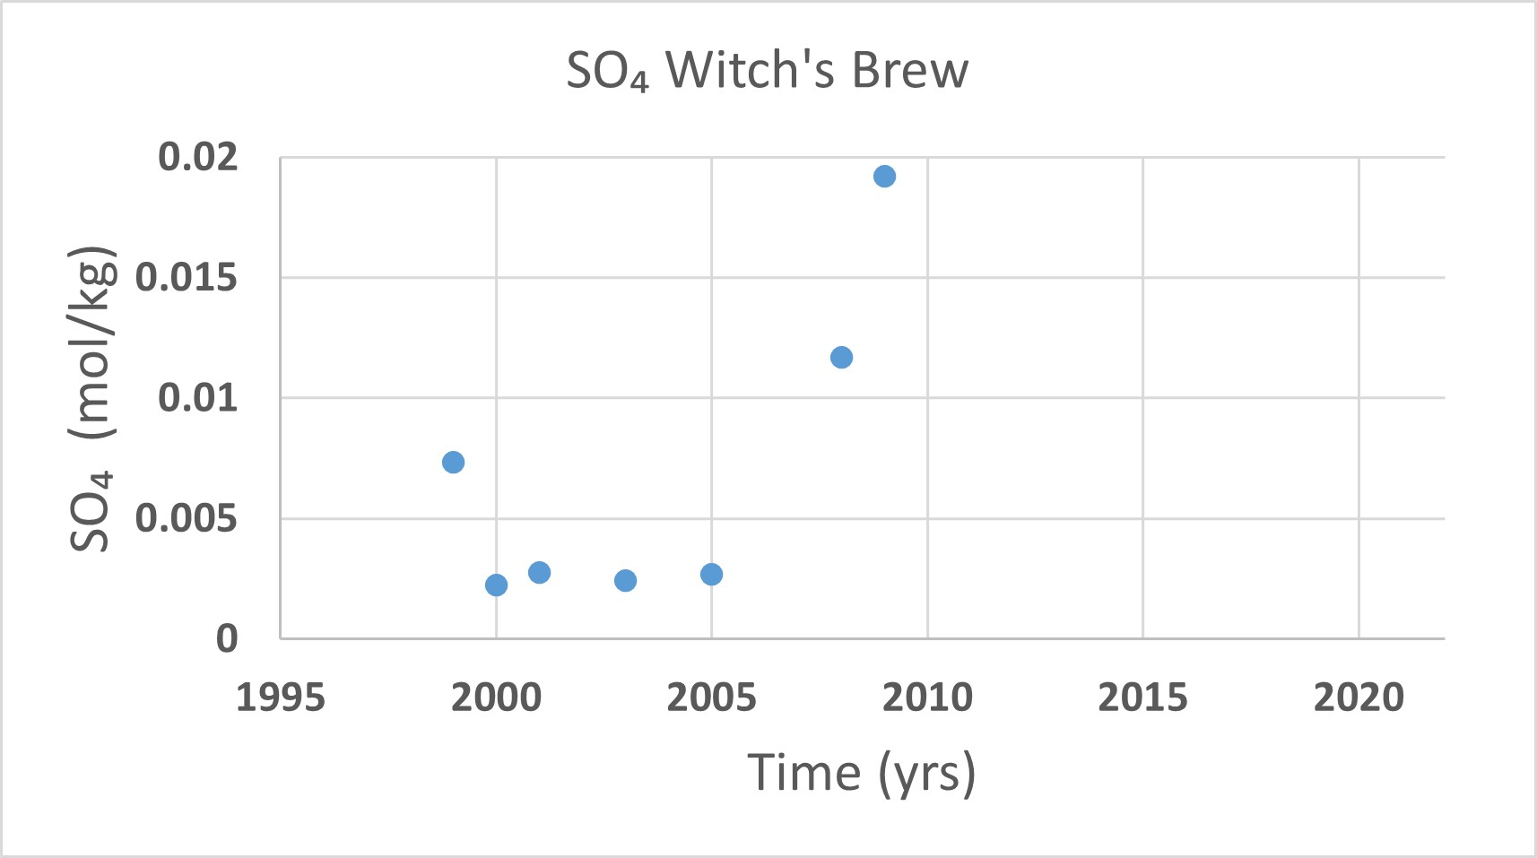
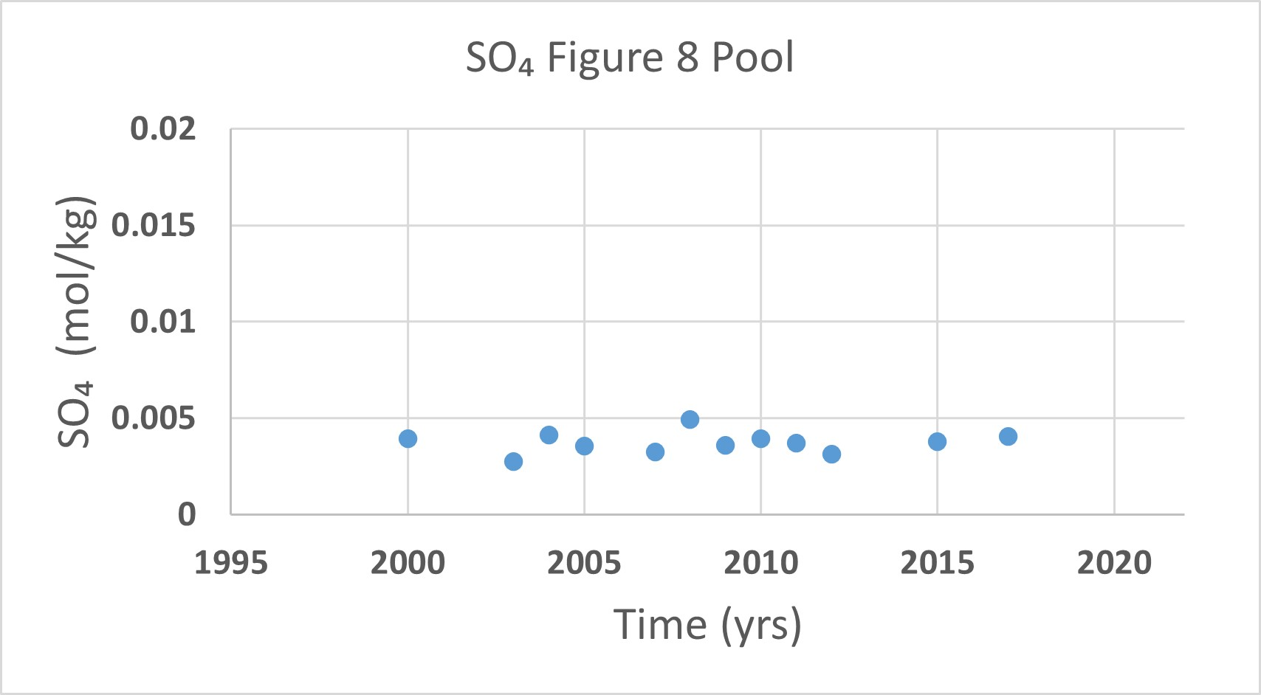
SO₄ v. Time (GOPA)
Notes:
- Error of ~5%
Show the deformation plots and pH and SO4 plots separately.
Describe how things change over time in many springs
Changes in SO4 suggest volcanic activity.

Slide 7
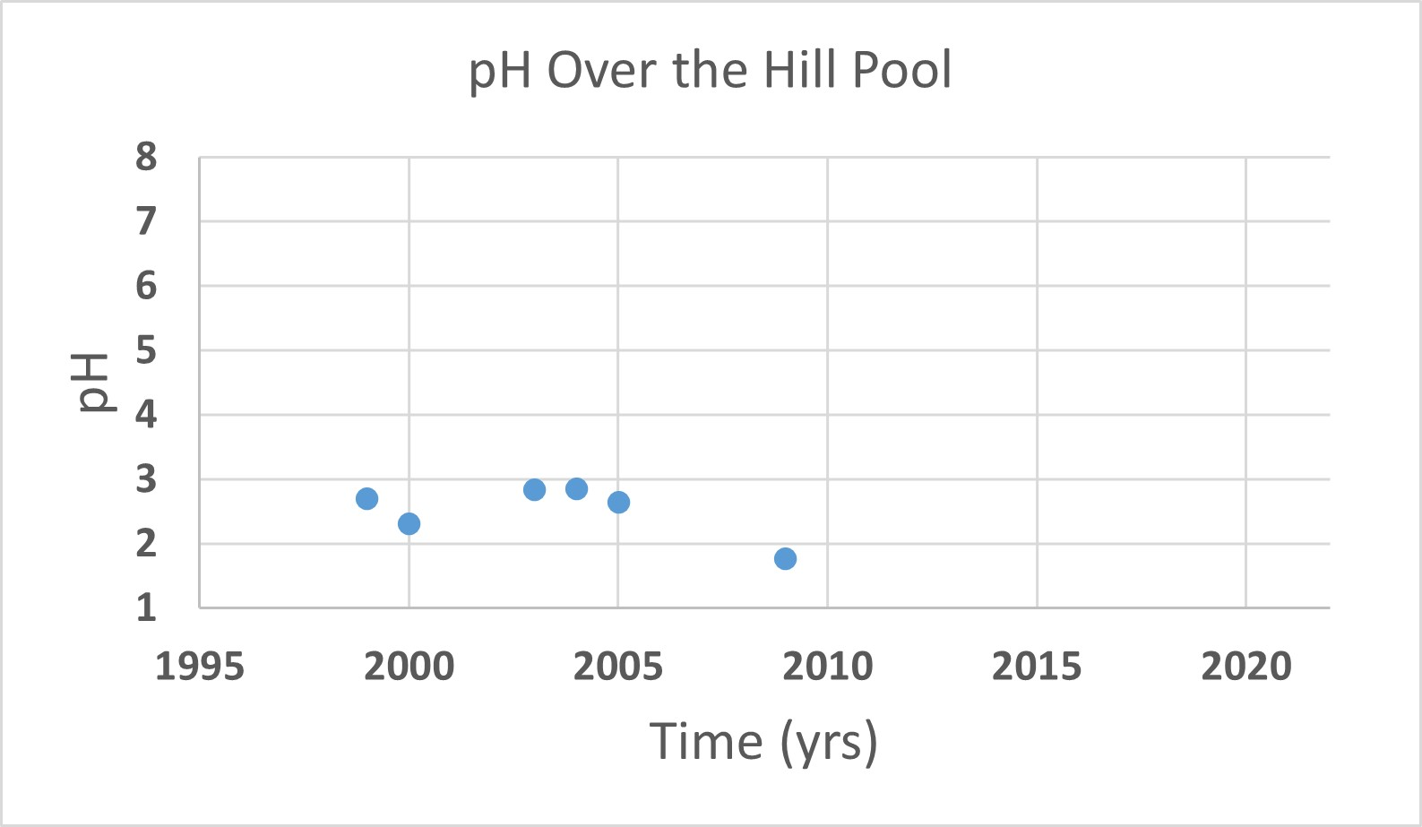
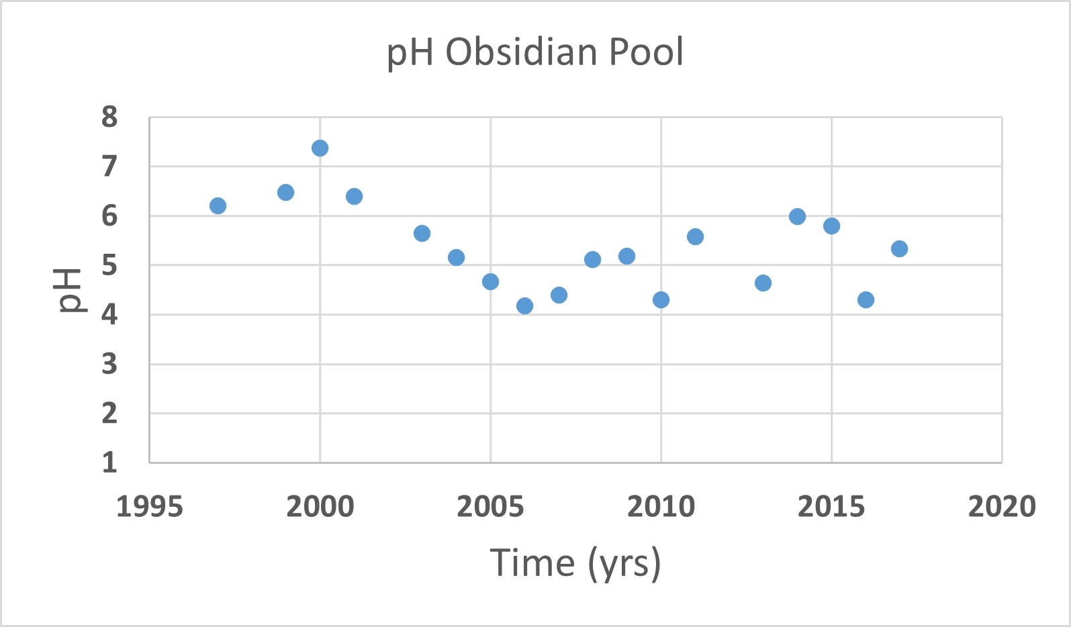
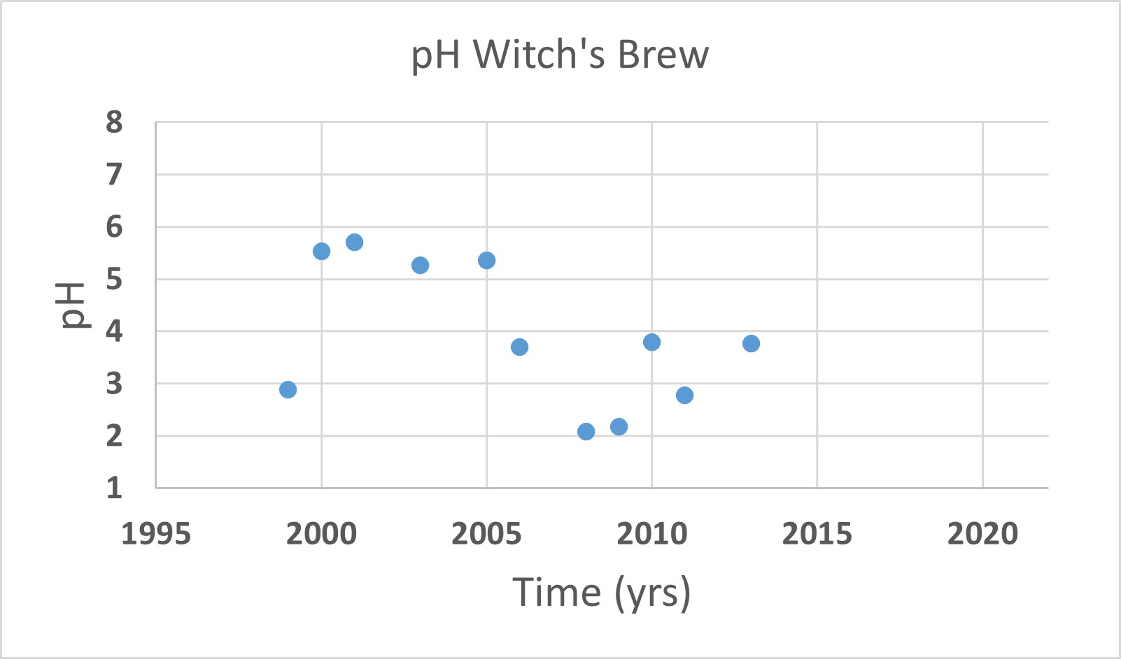
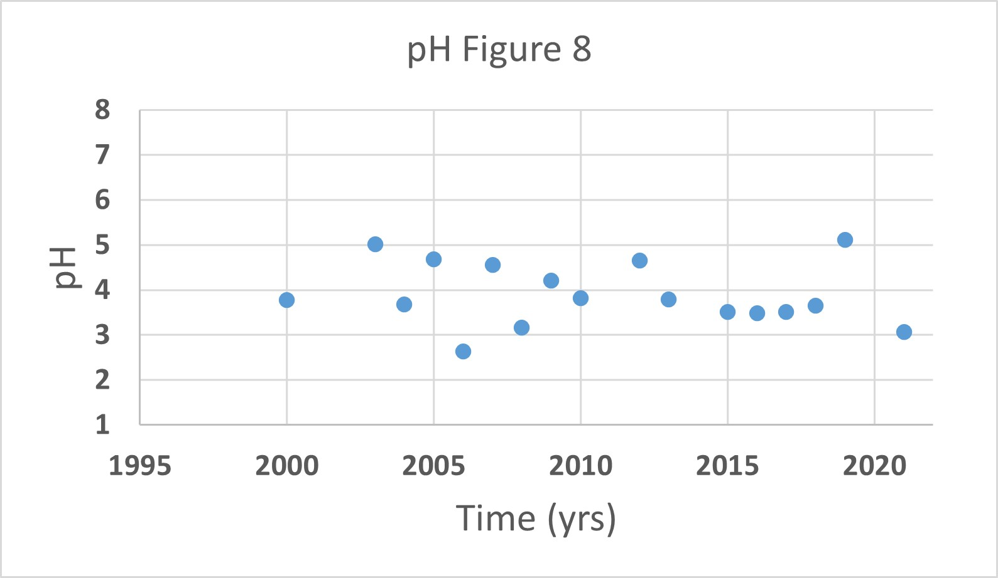
pH v. Time (GOPA)
Notes:
Show the deformation plots and pH and SO4 plots separately.
Describe how things change over time in many springs

Slide 8
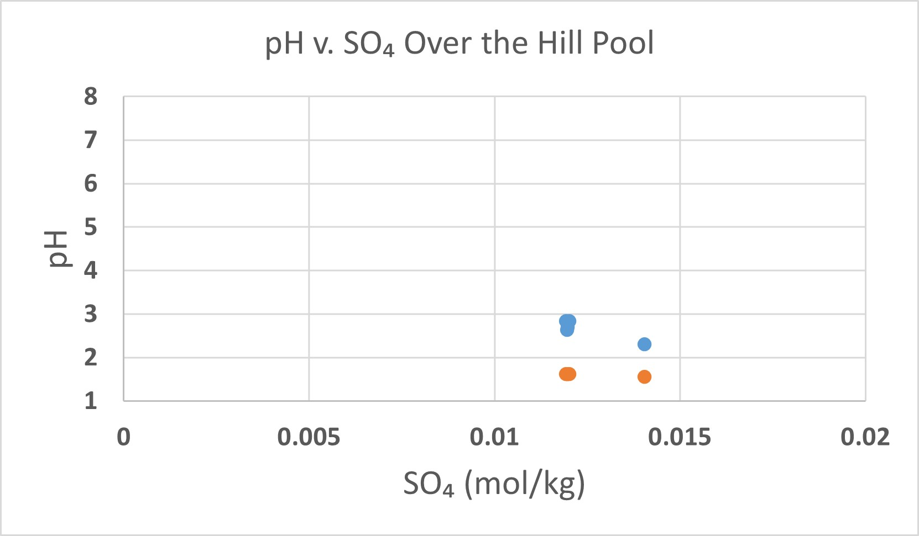
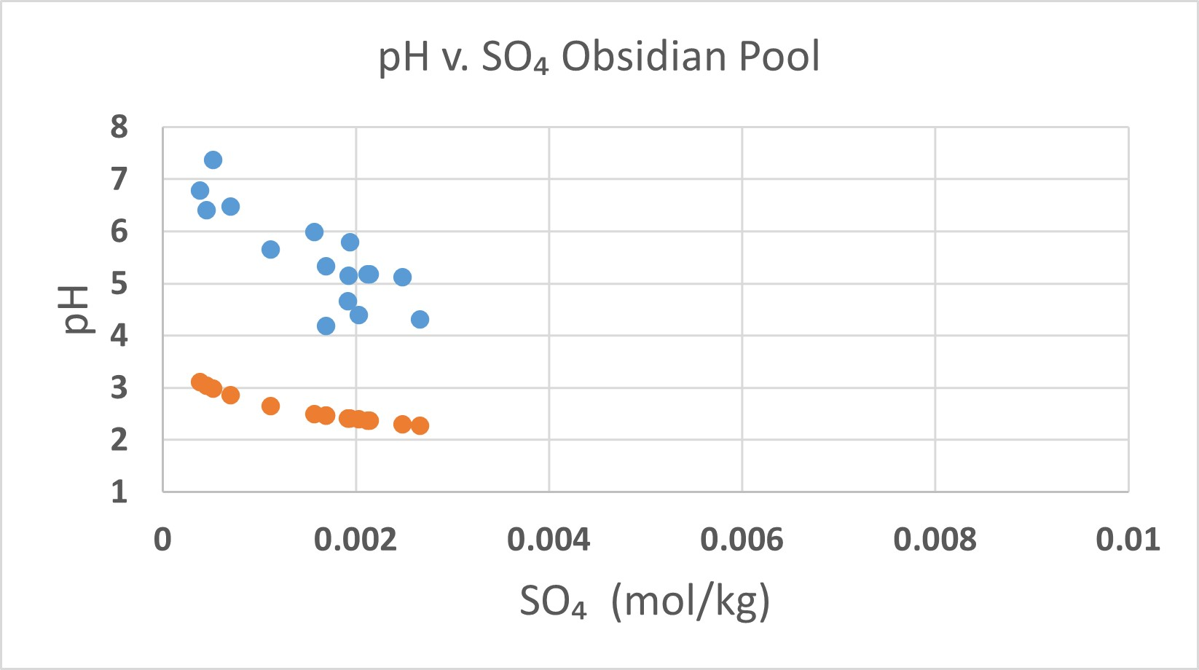
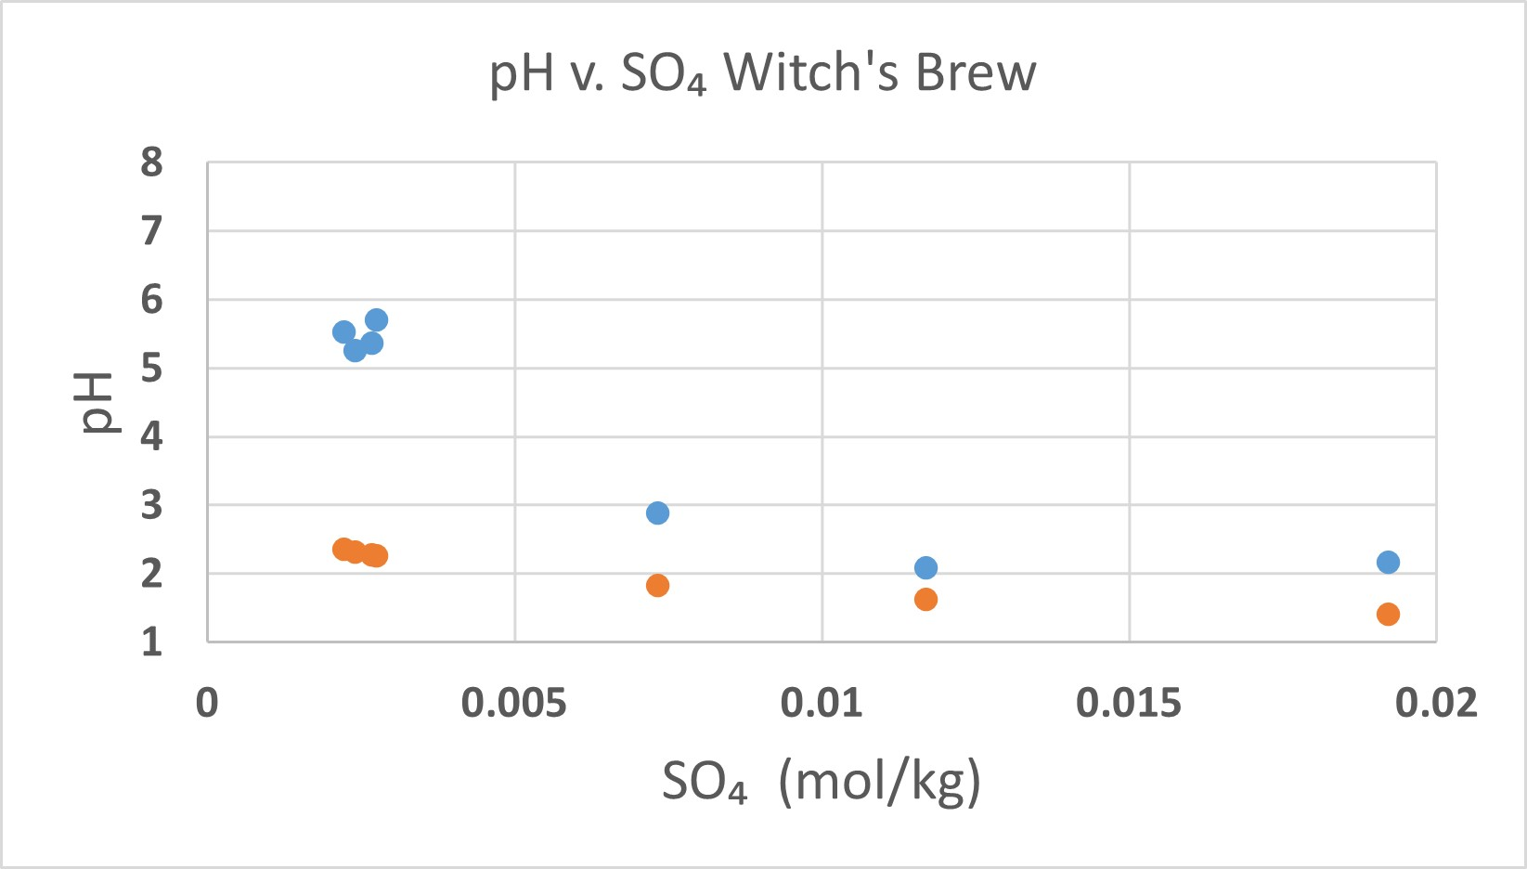
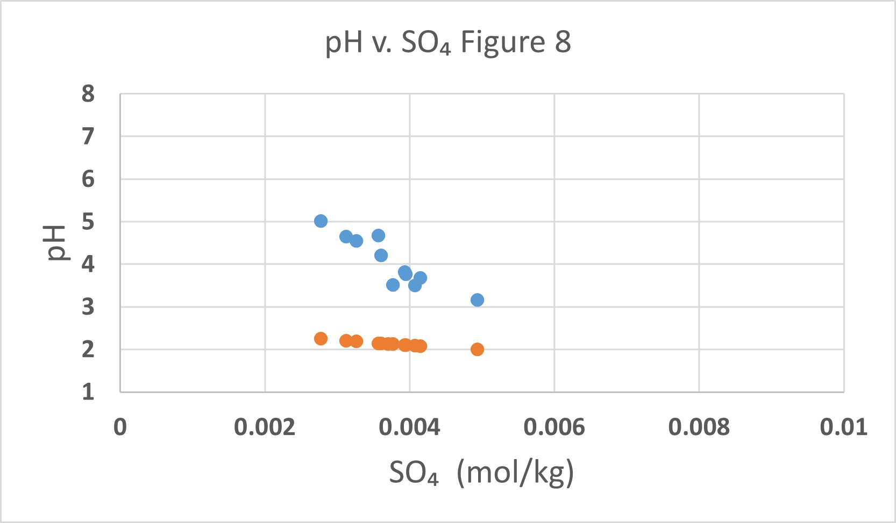
pH v. SO₄ (GOPA)
Notes:
We loose time, but can now visualize the relationships between the pH and SO4.

Slide 9
Summary
There is an observed large-scale physical deformation of the Yellowstone Caldera.
The deformation is thought to be associated with the hydrothermal or magmatic system.
Can changes observed in the geochemical dataset be explained by chemistry alone?
Conclusion: It is possible, but more data will be needed.
Deformation → Gas Flux → Hot Spring Chemistry
Notes:
Future work: what else can we do; what do we have…

Slide 10


Future Work and Acknowledgements
incorporate more hot spring regions
Include additional real-time geochemical and physical datasets.
Expand the types of measurements being collected from hot springs.
Thank you
GEOPIG research group
NASA Space Grant
Colleagues at SESE
Friends and family!
Notes:
Look into more hot spring regions to gain a broader perspective
Incorporate additional geochemical and physical datasets (being taken in real-time).

Slide 11
Sources
Hurwitz, S., & Lowenstern, J. B. (2014). Dynamics of the Yellowstone hydrothermal system. Reviews of Geophysics, 52(3), 375-411.
Tizzani, P., M. Battaglia, R. Castaldo, A. Pepe, G. Zeni, and R. Lanari (2015), Magma and fluid migration at Yellowstone Caldera in the last three decades inferred from InSAR, leveling, and gravity measurements, J. Geophys. Res. Solid Earth, 120, 2627–2647, doi:10.1002/2014JB011502.
Blewitt, G., Hammond, W. C., & Kreemer, C. (2018). Harnessing the GPS data explosion for interdisciplinary science. Eos, 99(10.1029), 485.
Google Earth Pro. (2015). Yellowstone National Park, WY. 44° 36’ 34.95’’ N, 110° 26’ 13.53’’ W, elev 7881 ft. [Accessed 4/14/2022].

